Slide 1
Types of loads and beams
Mechanics Activity

Slide 2
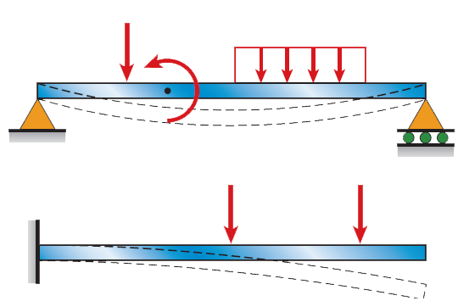
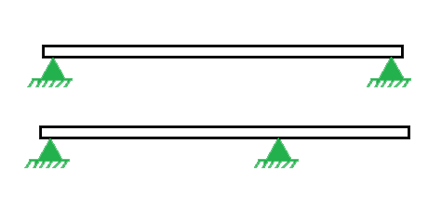
What We Are Doing
Types of Beam
Types of Load

Slide 3
01
About the Beams

Slide 4

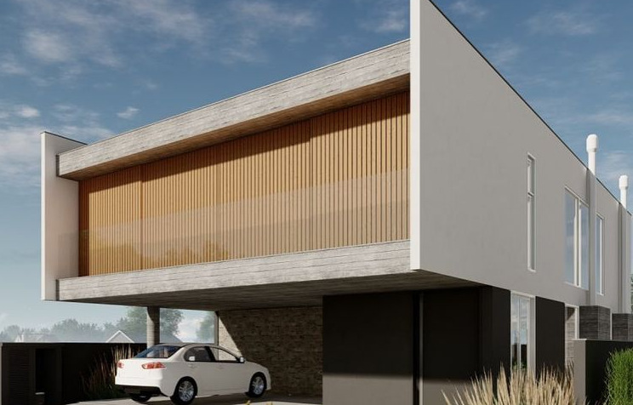
About the Beam
Cantilever beam
A Cantilever beam is a structural element that extends horizontally and is supported at only one end. Typically it extends from a flat vertical surface such as wall to which it must be firmly attached like other structural elements , a cantilever can be formed as beam, plate, truss or slab.

Slide 5
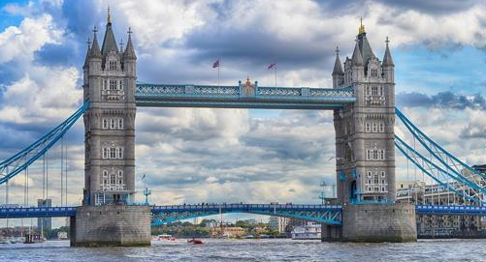
About the Beam
Simply Supported beam
A simply supported beam is one that rests on two supports and in free to move horizontally. Typical practical application of this with point loadings include bridges , beams in buildings.

Slide 6
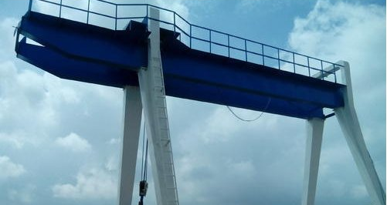
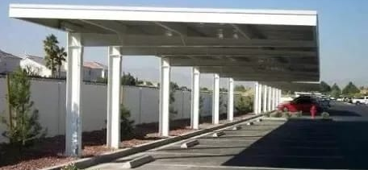
About the Beam
Over hanging beams
If the end portion of the beam extends beyond the support, then the beam is known as overhanging beam.
Overhanging beam may be supported on one of the side or maybe on both.

Slide 7
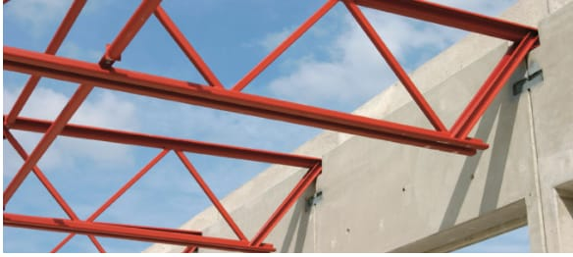
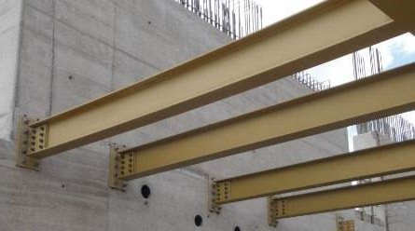
About the Beam
Fixed beam
A fixed beam is one that is fixed on both ends of the beam with supports. This type of beams does not allow for bending moment production and will not have any vertical movement or rotation. Fixed beams are most frequently used in trusses and similar structures.

Slide 8
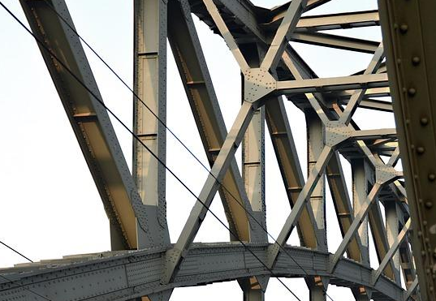
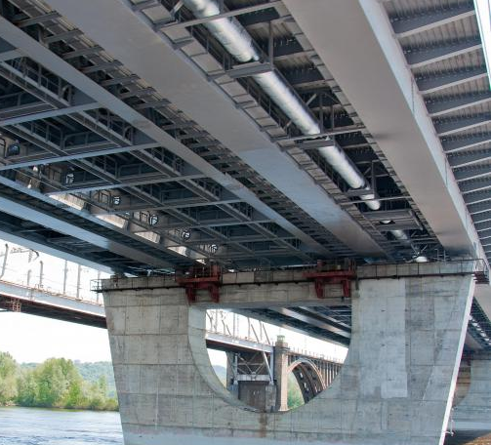
About the Beam
Continuous beam
A beam which has more than 2 supports is called continuous beam. This is statistically indeterminate and cannot be obtained with the equations of static equilibrium only. For the calculation of the reactions in the supports each section is considered as an independent beam.

Slide 9

Loads
A load is force , deformation or acceleration applied on a structural elements

Slide 10
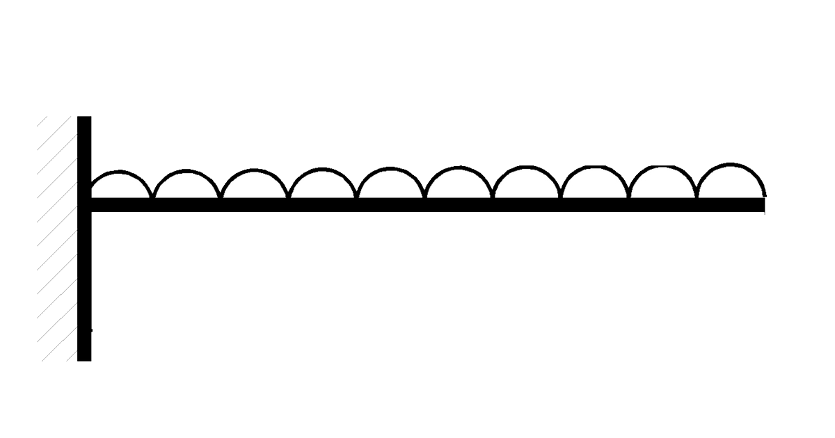
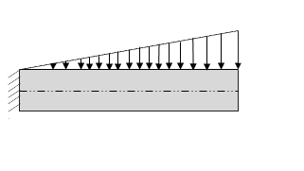
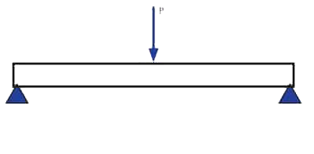
Types of load
Point load
Uniformly distributed load
Uniformly varying load

Slide 11
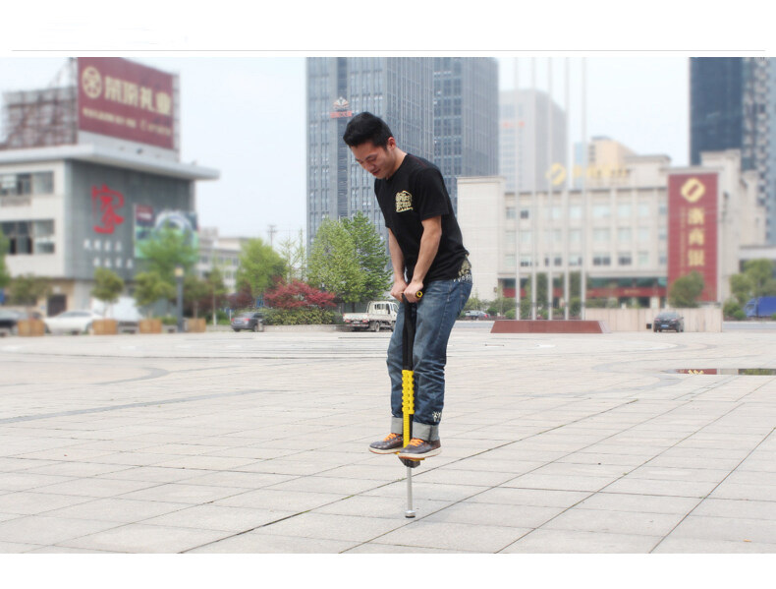
About the Load
Point load
Point load is a load which acts over a small distance.

Slide 12
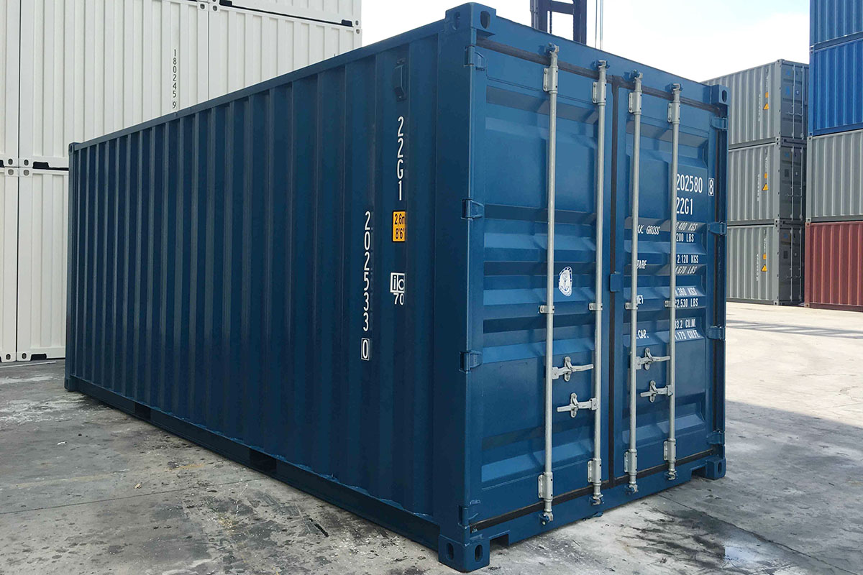
About the Load
Uniformly Distributed load
Uniformly distributed load is that whose magnitude remains uniform throughout the length

Slide 13
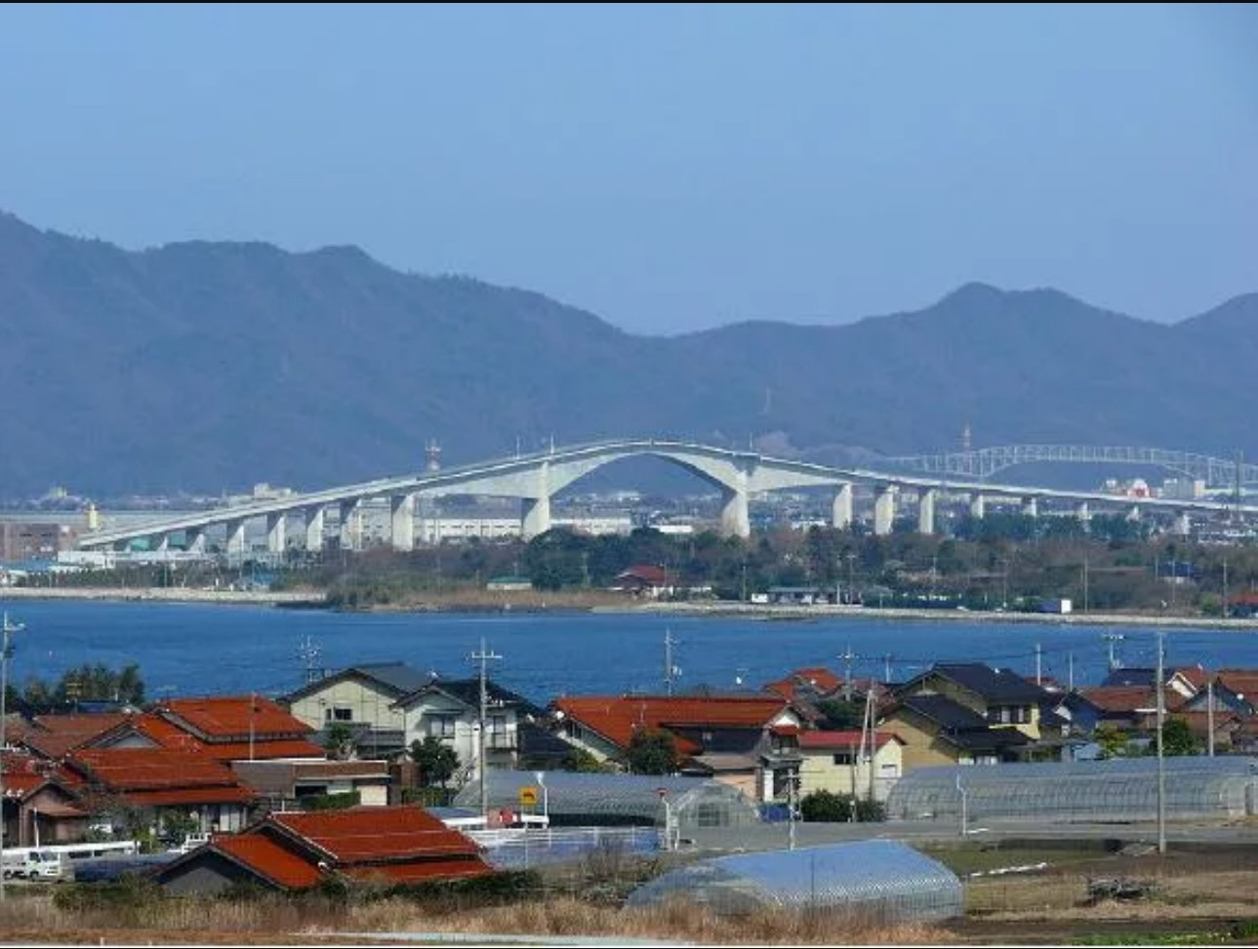
About the Load
Uniformly Varying load
Uniformly distributed load is that whose magnitude keeps varing throughout the length.

